Slide 1
COSMOS Basic
Made by Taufeeq Rahmani
Course Content
28th April 2016

Slide 2
Agenda.
Made by Taufeeq Rahmani
Introduction to Big Data
Introduction to Map Reduce
Introduction to COSMOS
Introduction to SCOPE
Important concepts and syntax in SCOPE

Slide 3
Big data is data that exceeds the processing capacity of conventional database systems
Processing of Big Data requires programs which span multiple physical and/or virtual machines working together in order to process all of the data in a reasonable span of time
Big data "size" is a constantly moving target, ranging from a few dozen terabytes to many petabytes of data
Applications of Big Data:
Social media network analyzing their members' data to learn more about them and connect them with content and advertising relevant to their interests
Search engines looking at the relationship between queries and results to give better answers to users' questions
Big data analytics has helped healthcare improve by providing personalized medicine and prescriptive analytics, clinical risk intervention and predictive analytics
Technology: eBay.com uses two data warehouses at 7.5 petabytes and 40PB as well as a 40PB Hadoop cluster for search, consumer recommendations, and merchandising

Slide 4
Agenda.
Introduction to Big Data
Introduction to Map Reduce
Introduction to COSMOS
Introduction to SCOPE
Important concepts and syntax in SCOPE

Slide 5
MapReduce is a processing technique and a program model for distributed computing
Let us take an example to understand this
We want to count (Query, URL) pairs that were clicked. Each machine has a log of the transactions it saw. We have many machines. The queries are distributed randomly over the machines. How can we do this using a cluster of machines?
At one time just knowing this information really improved the results because it boosted results that were clicked over those that weren’t clicked

Slide 6
Naïve Approach: Try running existing scripts in parallel
Made by Taufeeq Rahmani
Machine #1
Machine #2
Machine #3
Machine #4
Extent
Extent
Extent
Extent
GetPairs
GetPairs
GetPairs
GetPairs
Sort
Sort
Sort
Sort
Count
Count
Count
Count
Output
(Able, www.able.com), 33
(Baker, www.baker.com), 10
(wiki, www.wikipedia.com), 1034
. . .
(candy, www.candy.com ), 2
(wiki, www.wikipedia.com), 982
(zebra, www.zebra.com), 10
. . .

Slide 7
Naïve Approach: A merge operation is required!
Machine #1
Machine #2
Machine #3
Machine #4
Extent
Extent
Extent
Extent
GetPairs
GetPairs
GetPairs
GetPairs
“Merge” is required because the same Pair (i.e. “wiki”, “www.wikipedia.org”) might exist on multiple machines!
Sort
Sort
Sort
Sort
Count
Count
Count
Count
Merge
(Able, www.able.com), 33
(Baker, www.baker.com), 10
(wiki, www.wikipedia.com), 1034
. . .
(candy, www.candy.com ), 2
(wiki, www.wikipedia.com), 982
(zebra, www.zebra.com), 10
. . .
Output

Slide 8
Naïve Approach: Merges are not parallel
Made by Taufeeq Rahmani
Machine #1
Machine #2
Machine #3
Machine #4
Extent
Extent
Extent
Extent
GetPairs
GetPairs
GetPairs
GetPairs
Sort
Sort
Sort
Sort
Count
Count
Count
Count
Merge
This is 4 partitions. Multiply by 1000 and you see that Aggregation operations can be expensive!
Output

Slide 9
Map-Reduce is an algorithm that allows us to do everything in parallel
MAP Pairs to different machines
Machine #1 has all of the Pair_A items
Machine #2 has all of the Pair_B items
Machine #3 has all of the Pair_C items
REDUCE the data
All rows with a given Pair are bucketed on (only) one machine
Therefore grouping, sorting and counting or other aggregation works correctly!
This greatly reduces the amount of data!

Slide 10
Map - Reduce Everything runs in parallel
Machine #1
Machine #2
Machine #3
Machine #4
Extent
Extent
Extent
Extent
GetPairs
GetPairs
GetPairs
GetPairs
Map
Map
Map
Map
Sort
Sort
Sort
Sort
Count
Count
Count
Count
Output

Slide 11
Map - Reduce: Maps the n-grams to distinct buckets
(Able, www.able.com), 33
(Baker, www.baker.com), 10
(wiki, www.wikipedia.com), 1034
(candy, www.candy.com ), 2
(wiki, www.wikipedia.com), 982
(zebra, www.zebra.com), 10
Machine #1
Machine #2
Machine #3
Machine #4
Extent
Extent
Extent
Extent
“Map” puts all of the same Pairs onto one machine. This allows you to group by those 2 fields in subsequent processes
GetPairs
GetPairs
GetPairs
GetPairs
Map
Map
Map
Map
Sort
Sort
Sort
Sort
Count
Count
Count
Count
(zebra, www.zebra.com), 10
(Able, www.able.com), 33
(wiki, www.wikipedia.com), 1962
. . .
(candy, www.candy.com ), 2
(Baker, www.baker.com), 10
. . .
Output

Slide 12
Map - Reduce: Everything runs in parallel
Machine #1
Machine #2
Machine #3
Machine #4
Extent
Extent
Extent
Extent
GetPairs
GetPairs
GetPairs
GetPairs
Map
Map
Map
Map
Sort
Sort
Sort
Sort
“Count” REDUCES the amount
of data since each Pair is only output once
Count
Count
Count
Count
Output

Slide 13
Map - Reduce: Everything runs in parallel
Machine #1
Machine #2
Machine #3
Machine #4
Extent
Extent
Extent
Extent
MAP
GetPairs
GetPairs
GetPairs
GetPairs
Map
Map
Map
Map
Sort
Sort
Sort
Sort
REDUCE
Count
Count
Count
Count
Output

Slide 14
Agenda.
Introduction to Big Data
Introduction to Map Reduce
Introduction to COSMOS
Introduction to SCOPE
Important concepts and syntax in SCOPE

Slide 15
COSMOS is Fault-tolerant distributed storage and computational platform
Fault tolerant
Resilient to hardware and software errors
Distributed
Commodity servers in a single environment
Storage
Manages “streams” of data (think files)
Supports mechanisms to analyze data in place
Computation
Failures tolerated at multiple levels
Multiple production environments
Data is 3x replicated for reliability
Repository for data
Data is our product!!
Platform for computation
Map-Reduce+ system built & used internally by Microsoft
Cost Effective
Build large scale data processing applications
Notes:
Cosmos is a data storage and processing platform. The goal of Cosmos is to give users the ability to store and process large amounts of data (TiB to PiB) quickly and easily with simple to write SCOPE scripts(which we will discuss in later parts of this session). Our processing paradigm is a version of "Map-Reduce" which runs on top of the "Cosmos File System" (CFS), which is a distributed file system. For job execution, we've incorporated Dryad, a computation framework developed in MSR. Additionally, Cosmos is a hosted service; teams do not create their own clusters but rather are allocated quotas in the Cosmos clusters hosted by the Cosmos team.

Slide 16
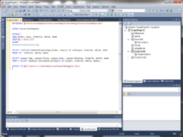
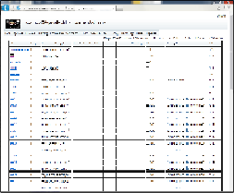

Basic Concepts of Cosmos
All data is stored in 3 copies across different nodes – highly reliable storage
Visual Studio used to author and submit jobs
Web portal used to view data in cluster and job queues
Tools/API’s available for automation against Cosmos
Cosmos Node
Cosmos jobs leverage parallelism and bring computation to the data - efficient execution of processing over massive data sets
Stores some data
VC’s are allocated to teams – your team will have one or more VC’s (ask your manager or colleagues)
VC’s are ‘containers’ for data – data paths are relative to your VC and you only see data in your VC or shared to your VC
Processes Data
Each VC has a “queue”. Jobs in Cosmos are submitted to a VC queue and wait to be run in priority order.
VC’s are guaranteed a minimum processing allocation in the shared cluster
Data in Cosmos is stored in “Streams” (think Files).
Stream
Cosmos Cluster
Extent 1
Jobs read data from streams, and write data to streams
Extent 2
VC 1
VC 2
VC 3
VC 4
VC 5
Extent 3
Streams can be uploaded to and downloaded from Cosmos
Extent 4
Extent 5

Slide 17
Cosmos Service Architecture
Streams
Named collection of data
Extents
Physical unit of storage
Streams have path names
Data in extents is compressed (efficiently)
Multiple streams can contain the same extent (linking)
Just an array of ‘extents’
Extents are roughly 250 MB
Virtual Cluster Web Service
Streams
Jobs
Cosmos Store Manager
Cosmos Job Scheduler
Job Mgr1
Job Mgr2
Job Mgr3
Nodes
Nodes
Nodes
Nodes
Nodes
Nodes

Slide 18
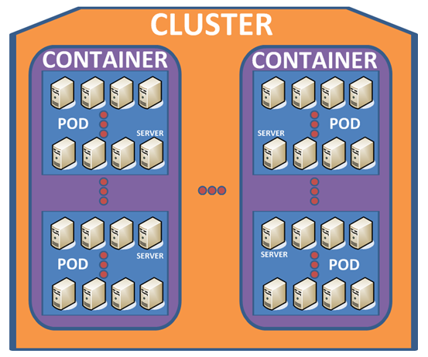
Common Terminology & data organization in COSMOS
Virtual Cluster (VC) : A virtual directory that users manage and use to interact with Cosmos.
Scope : Cosmos' custom language for processing data
Job : A single SCOPE program that runs as a distributed computation using VC directories and resources.
Extent : Cosmos' unit of storage.
Stream : Immutable files stored in a VC that user's read from to process data.
Vertex: Cosmos' unit of execution.
Node: A machine in Cosmos
Token: A contractual guarantee that a high priority vertex will be provided. One token guarantees a single high priority vertex.
Notes:
Cosmos consists of three clusters, each cluster with eight-to-ten containers, each container with forty pods, and each pod with forty-five servers.

Slide 19
Agenda.
Introduction to Big Data
Introduction to Map Reduce
Introduction to COSMOS
Introduction to SCOPE
Important concepts and syntax in SCOPE

Slide 20
SCOPE – The language of COSMOS
Goes beyond Map-Reduce : Allows for flexible computations
Leverages.NET functionality : Added advantage of C# blocks & error handling
Read data from streams or views
Write data to streams
User Defined Operator : Powerful enough to support complex applications
SQL-like syntax for data flow but it is not SQL

Slide 21
SCOPE : An Overview
Made by Taufeeq Rahmani
SCOPE supports most .NET Data types, even nullable versions
SCOPE supports User defined data types as well. Users can create .NET collections : lists, tuples etc.
SCOPE supports following logical operators : AND & OR
SCOPE allows users to call .NET methods in SELECT clause for which the rowset columns are strongly typed
SCOPE supports LINQ(Language integrated query) query syntax & method syntax
SCOPE supports regular expressions

Slide 22
SCOPE : Language Statements Summary
Input / Output
EXTRACT : Read data from stream
Processing Data
SELECT : The “One Ring”
OUTPUT : Write data to stream
Custom Processing Commands(SCOPE Objects)
PROCESS : Invoke a user defined processor
REDUCE : Invoke a user defined reducer
COMBINE : Invoke a user defined combiner
Dependencies
REFERENCE : Load .NET assembly
RESOURCE : Provide arbitrary file to user defined object

Slide 23
Agenda.
Introduction to Big Data
Introduction to Map Reduce
Introduction to COSMOS
Introduction to SCOPE
Important concepts and syntax in SCOPE

Slide 24
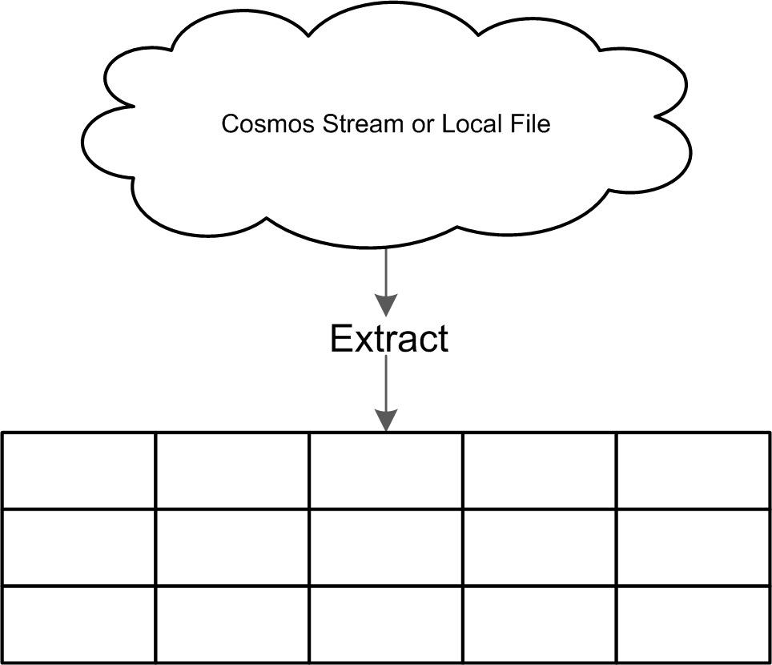
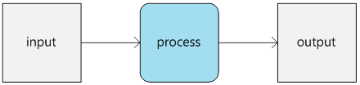
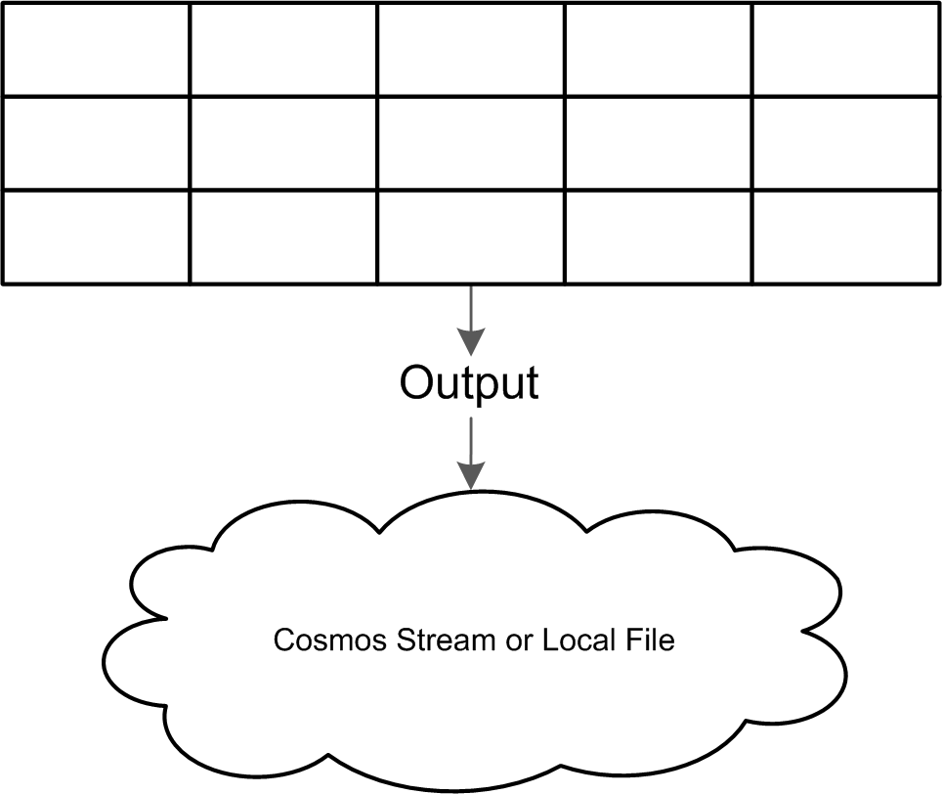
Rowset forms the basic block of any process in SCOPE
Use an EXTRACT command to convert a stream into a RowSet
All other commands work only with RowSets
Rows are used to store and pass data through the system
RowSet: a list of Rows
Use an OUTPUT command to convert RowSets into a stream
Notes:
At a first level of approximation, a Scope script maps some input to some output via a processing step.
Inputs and outputs are Streams – essentially a file-like data structure that can be read from or written out. (Views can also be inputs. This will be covered later). In other words, streams are persisted entities. During processing an input stream is transformed into a rowset. Rowsets – similar to an intermediate table – are how Scope internally passes data during script execution. That rowset may be transformed to other rowsets. Finally a rowset may be persisted back out as a stream

Slide 25
Scope is the Query Language for Cosmos
Sample SCOPE script
rs0 = EXTRACT
FirstName : string,
LastName : string,
Age : int
FROM "/test_input.tsv"
USING DefaultTextExtractor();
OUTPUT rs0
TO "/test_output.tsv"
USING DefaultTextOutputter();
Key points:
Because the stream in unstructured, the EXTRACT command explicitly names the columns and the types in the stream.
The OUTPUT command sends the rows from rowset rs0 to an output stream (in this case a local file).
PROTIP: Calling DefaultTextExtractor without any arguments is equivalent to DefaultTextExtractor( delimiter: 't' ) which explicitly identifies that the file is delimited by tabs

Slide 26
There are 3 kinds of Inputs in SCOPE
Streams
Also referred to as unstructured streams, a stream is a persisted, file-like input. For example, any text file is a stream
Scope extracts data from streams and processes that data
Scope has the native ability to extract data from simple text streams (via the DefaultTextExtractor) which satisfies most scenarios
Developers can also build custom extractors to read data from other formats such as binary, JSON, or XML
Structured Streams
Structured streams are streams that are optimized for storage and access based on some unique properties (keys) of individual records
structured streams are directly used without an extractor or an outputter
They offer greater performance than unstructured streams
Views
A VIEW simplifies reading from streams similar to the VIEWS in SQL
*Streams and Structured Streams are also used as Outputs

Slide 27
Data Types in SCOPE
Category | Data type | Nullable Data type
Miscellaneous | bool Guid datetime byte[] | bool? Guid? datetime?
Numeric | byte sbyte int uint long ulong float double decimal short ushort | byte? sbyte? int? uint? long? ulong? float? double? decimal? short? ushort?
Text | char string | char?
Complex | MAP<k,v> ARRAY<v>

Slide 28
The SELECT clause, as in SQL, allows you to pick the columns of interest
Example:
searchlog = VIEW "Views/SearchLog.view";
// Find all the session dates, Durations
rs1 =
SELECT Start, Region, Duration
FROM searchlog;
OUTPUT rs1
TO "/my/output.txt";
Important commands in SCOPE
In the above statement, we are selecting Start, Region and Duration as the columns and then sending the result to output.txt
The FROM statement, defines the source from which a rowset is taken
WHERE and HAVING clauses allow you to filter data. WHERE operates on input rows and HAVING on output rows
Logical operators such as AND and OR are supported.
You can sort rowsets by using the ORDER BY operator. Specifying the ASC and DESC keyword controls whether the sort is ascending or descending

Slide 29
Logical Operators in Expressions
Both C# and SQL style operators can be used in SCOPE
 | C# | SQL
Logical AND with short-circuiting | (a && b && c) | ALL( a, b, c)
Logical OR with short-circuiting | (a || b || c) | ANY( a, b, c)
Logical NOT | !a | NOT(a)
NOTE: Just like C, C++, and C#, Scope has the conditional operator, whose form is shown below:
cond ? a : b
Example: rs1 =
SELECT Region,
(Duration>300 ? "long" :"short") AS DwellType
FROM searchlog;

Slide 30
CROSS APPLY can be used to break apart Rows
Suppose we want to transform the input rowset.
Input Rowset:
Output Rowset:
SCOPE Code:
rs1 =
SELECT
Region,
Urls
FROM searchlog;
rs2 =
SELECT
Region,
SplitUrls AS Url
FROM rs1
CROSS APPLY Urls.Split(';') AS SplitUrls;
Region | Urls
en-us | A;B;C
en-gb | D;E;F
Region | Urls
en-us | A
en-us | B
en-us | C
en-gb | D
en-gb | E
en-gb | F

Slide 31
The List function can be used to do the exact opposite of CROSS APPLY
Suppose we want to transform the input rowset.
Input Rowset:
Output Rowset:
SCOPE Code:
rs3 =
SELECT
Region,
string.Join(";" , LIST(Url).ToArray() ) AS Urls
FROM rs2
GROUP BY Region;
Region | Urls
en-us | A
en-us | B
en-us | C
en-gb | D
en-gb | E
en-gb | F
Region | Urls
en-us | A;B;C
en-gb | D;E;F

Slide 32
Sequence of Execution of statements
FROM
GROUP BY
HAVING
WHERE
SELECT
DISTINCT
ORDER BY
TOP

Slide 33
AND/OR versus ALL/ANY
Before learning about the ALL or ANY we'll need to discuss how the logical AND and OR operators work in Scope. Expressions using AND and OR operators are optimized by the Scope runtime. But there is no guarantee of the order of evaluation of the expressions.
The ALL and ANY operators are conceptually equivalent to a series of expressions linked by ANDs or ORs.
ALL is conceptually equivalent to (e1 AND e2 AND … AND en)
ANY is conceptually equivalent to (e1 OR s2 OR … OR en)
However in the case of ALL or ANY, because the optimizer does not alter the order of expression evaluation.
Which one should you use?
In general start by using AND and OR. Only use ALL or ANY if you MUST guarantee that the expressions must be evaluated in a certain order.

Slide 34
Sorting and Selecting DISTINCT values in SCOPE
Sorting
You can sort rowsets by using the ORDER BY operator. Specifying the ASC and DESC keyword controls whether the sort is ascending or descending, respectively.
rs1 = SELECT Start, Market, DwellTime FROM searchlog ORDER BY DwellTime ASC;
OUTPUT rs1 TO @"/my/ScopeTutorial/SampleOutputs/output.txt";
Getting the TOP N Rows
What if we want only 5 rows? We can use TOP for selecting the TOP ‘n’ rows( Similar to SQL)
rs1 = SELECT TOP 5 Market, DwellTime FROM searchlog;
Finding Distinct Values with DISTINCT
We can use DISTINCT to get the distinct values from a rowset
rs1 = SELECT DISTINCT Market FROM searchlog;

Slide 35
Grouping and Aggregation
Grouping, in essence, collapses multiple rows into single rows based on some criteria. Hand-in-hand with performing a grouping operation, some fields in the output rowset must be aggregated into some meaningful value (or discarded if no possible or meaningful aggregation can be done)
rs1 = SELECT Market, DwellTime FROM searchlog;
rs2 = SELECT Market, SUM(DwellTime) AS TotalDwellTime FROM rs1 GROUP BY Market
HAVING TotalDwellTime > 200;
NOTE
You must give the aggregate column a name with the AS keyword
The GROUP BY keyword is optional –if not present, Scope assumes an implicit GROUP BY on all columns present outside an aggregation command (SUM, COUNT, MIN, MAX, …). However, The COSMOS Team strongly urges all Scope developers to be explicit and always explicitly add the "GROUP BY".

Slide 36
DISTINCT vs GROUP BY
SELECT DISTINCT
For SELECT DISTINCT, x,y,z scales well. This operation sorts data wherever it currently is, partitions by all columns, then does a tree of merge sorts (eliminating duplicates) until all distinct values that belong in a single partition are on a single machine. That scales well because the duplicates are eliminated along the way.
In general, using a DISTINCT statement is ok towards the end of your script, but you’ll want to avoid using this at the beginning, as it pulls your job onto one machine, rather than distributing your job across many.
On the contrary, SELECT COUNT(DISTINCT x) should rarely be used, because it requires all the rows with a given value of x to be sent to a single machine before any of them can be eliminated.
GROUP BY
With GROUP BY statements, you want to group by something that is well-distributed. For example, if you group by RGUID, you will have aggregation occur in a distributed fashion. If you choose MBDATE, MediumId, Matchtype, or other keys that have few values, you end up forcing the aggregation down to fewer machines

Slide 37
Additional Links
Introduction to Big Data
https://en.wikipedia.org/wiki/Big_data
Introduction to Map Reduce
https://en.wikipedia.org/wiki/MapReduce
https://www-01.ibm.com/software/data/infosphere/hadoop/mapreduce/
http://www.tutorialspoint.com/hadoop/hadoop_mapreduce.htm
Introduction to COSMOS
https://microsoft.sharepoint.com/teams/Cosmos/Wiki/Cosmos%20Bootcamp.aspx
https://microsoft.sharepoint.com/portals/hub/_layouts/15/PointPublishing.aspx?app=video&p=c&chid=34096c7f-eb54-4cb5-ab22-fa237c95a92c&s=0&t=pfb
Introduction to SCOPE
https://microsoft.sharepoint.com/teams/Cosmos/Presentations/_layouts/15/start.aspx#/SitePages/Home.aspx
https://microsoft.sharepoint.com/teams/Cosmos/SitePages/Scope.aspx
https://microsoft.sharepoint.com/teams/Cosmos/Documents/Forms/AllItems.aspx?RootFolder=/teams/Cosmos/Documents/Scope/Tutorial&FolderCTID=0x01200012F908FF3C0C2C41B24C5E56ADD0C5C7

